Slide 1
AWS IoT Sensor Data Pipeline
By Ashish

Slide 2
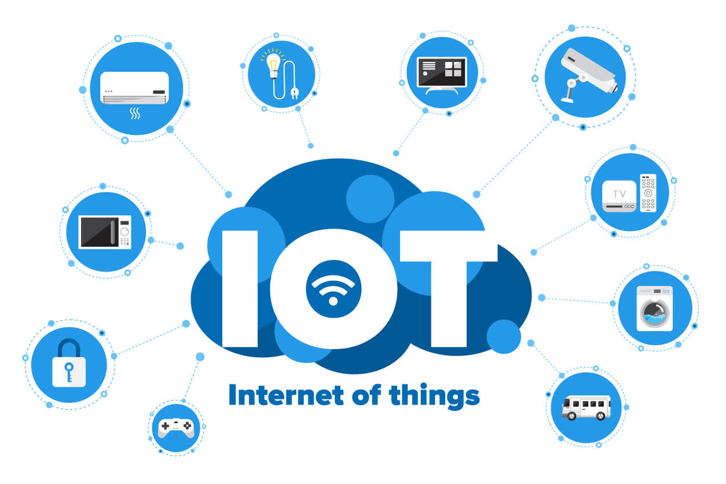
Introduction
IoT Devices mainly deal with data through sensors
These devices usually process that data through the cloud
Purpose:Collect, process, and store sensor data securely and reliably
Approach: Use AWS services for scalability, automation, and cost-efficiency

Slide 3
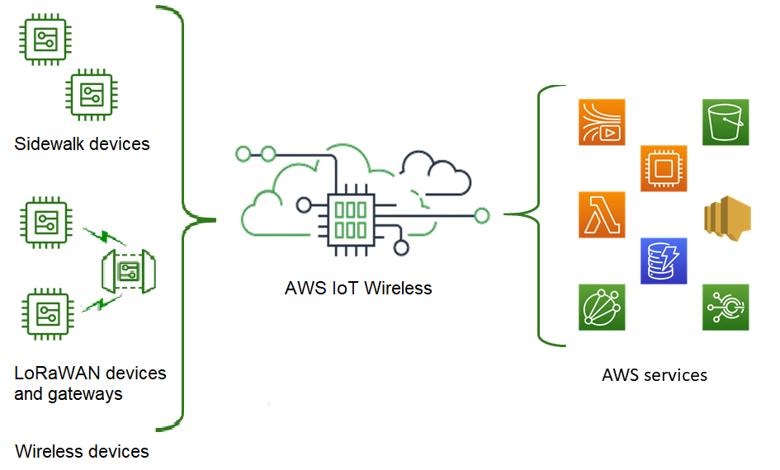
Goals of the Project
Enable IoT sensor data ingestion via API
Store real-time sensor readings in DynamoDB
Maintain a backup of readings in S3
Simulate IoT device using EC2 instance
Demonstrate an end-to-end IoT pipeline on AWS

Slide 4
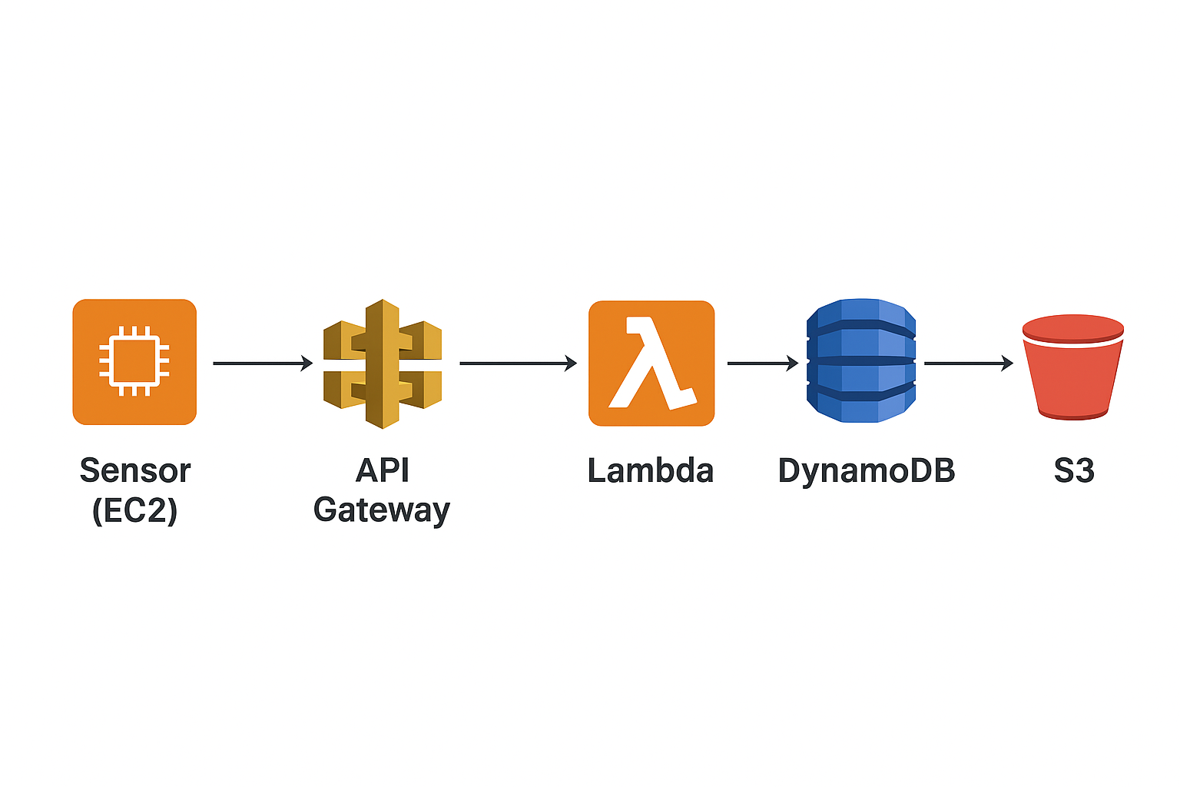
Workflow
Sensor (EC2) generates readings.
Data sent to API Gateway.
Lambda function processes data.
Data stored in DynamoDB.
Backup saved in S3 bucket.

Slide 5
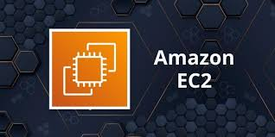
EC2
What is it:
EC2 provides virtual servers in the cloud.
Can run applications, simulations, or scripts.
Offers full control over the environment.
How it’s used in this project:
Simulates IoT devices sending data.
Python script continuously sends sensor readings to API Gateway.

Slide 6
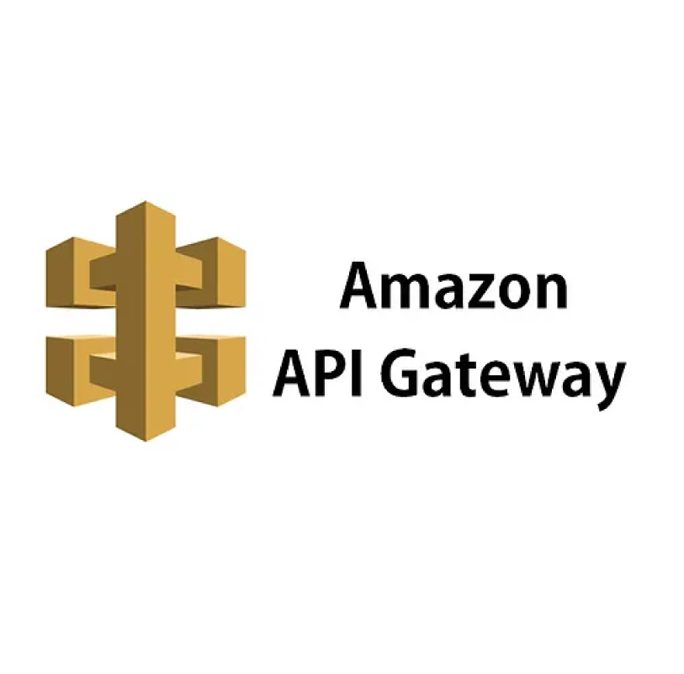
API Gateway
What is it:
API Gateway manages HTTP and REST APIs for applications.
It acts as a secure entry point for all data coming into AWS services.
Handles requests efficiently and can scale automatically.
How it’s used in this project:
Created a POST route.
Sends incoming sensor data to AWS Lambda for processing.

Slide 7
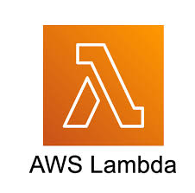
AWS Lamda
What is it:
Lambda runs your code without needing servers.
Automatically scales to handle many requests.
Helps automate tasks and data processing.
How it’s used in this project:
Extracts sensor data from API Gateway requests.
Saves the data into DynamoDB tables.
Uploads a backup file to S3 for recovery.

Slide 8
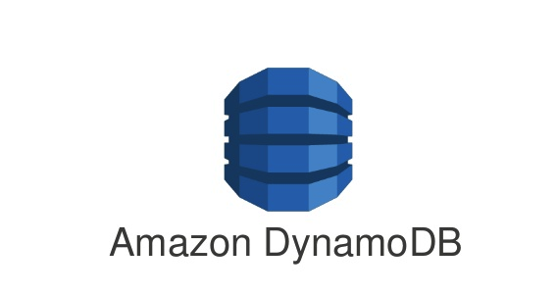
DynamoDB
What is it:
DynamoDB is a fast, fully managed NoSQL database.
Stores data in tables with key-value format.
Can handle large amounts of data efficiently.
How it’s used in this project:
Table name: SensorReadings.
Primary key: Timestamp.
Stores all sensor readings collected from devices.

Slide 9
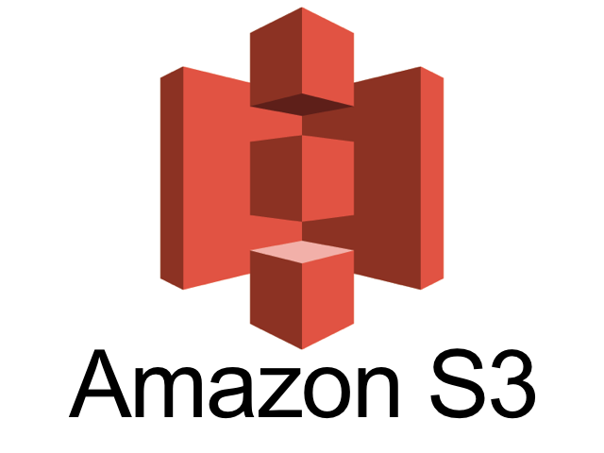
S3
What is it:
S3 is scalable object storage for files and backups.
Very reliable and secure for storing large amounts of data.
Often used for logs, backups, or static content.
How it’s used in this project:
Stores JSON files containing sensor data.
Acts as backup to recover data if needed.

Slide 10
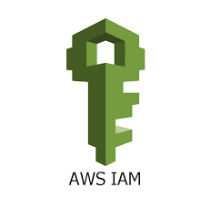
IAM
What is it:
IAM (Identity and Access Management) controls access to AWS services.
Ensures only authorized users or roles can access resources.
Helps maintain security and proper permissions.
How it’s used in this project:
Lambda role has permissions to access DynamoDB and S3.
Ensures Lambda can read/write sensor data and backup files securely.

Slide 11
How I Built the Project
Created Lambda function with code to process sensor data.
Extracts data, saves it to DynamoDB, and backs up to S3.
Assigned a role with IAM permissions to access DynamoDB and S3.
Created API Gateway with POST route
Connected it to Lambda to receive data from devices.
Launched EC2 instance to simulate IoT device.
Ran Python script to continuously send sensor readings to API Gateway.
Created DynamoDB table
Stores all incoming sensor data from Lambda.
Created S3 bucket to store JSON backup files of sensor data.
Tested full workflow: EC2 → API Gateway → Lambda → DynamoDB & S3.

Slide 12
Output
DynamoDB → Stores rows with timestamp & temperature.
S3 → Contains JSON backup files.
API Response → Success message.
EC2 Console → Shows sensor activity.

Slide 13
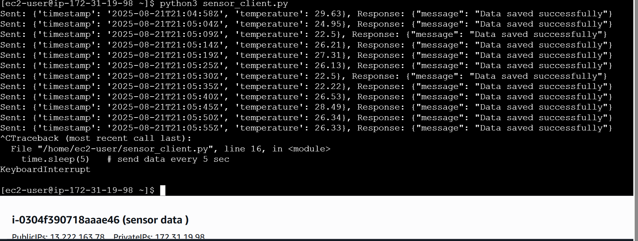
EC2 (Sensor data simulation)

Slide 14
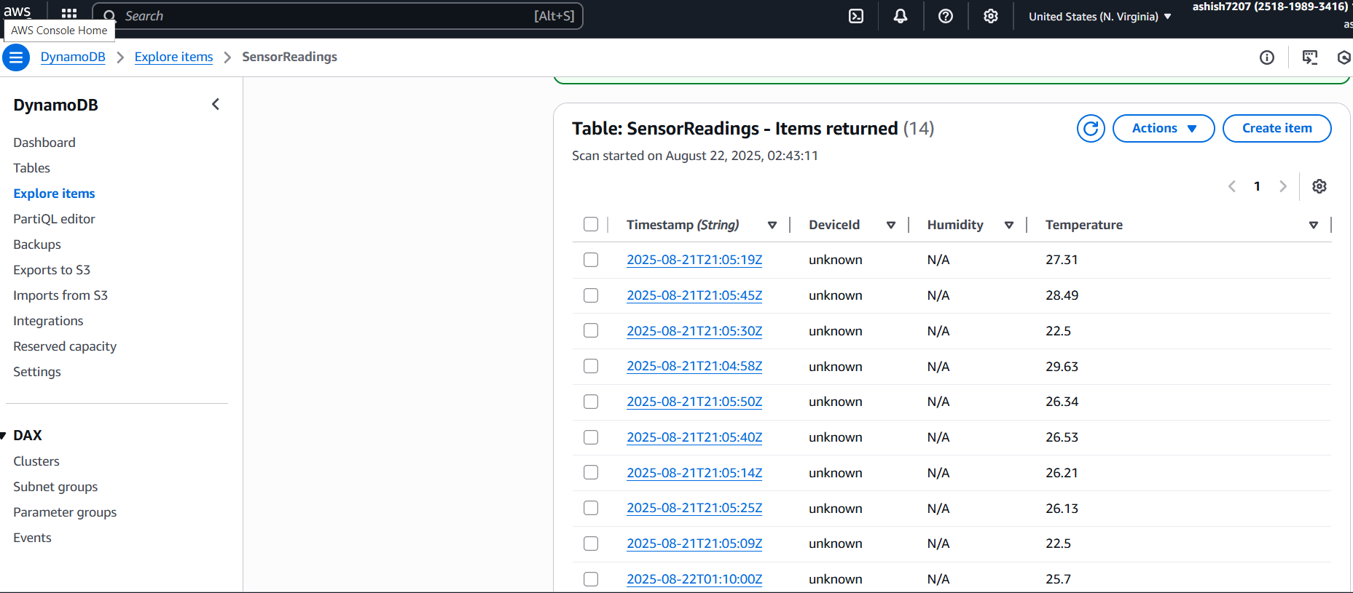
DynamoDB output

Slide 15
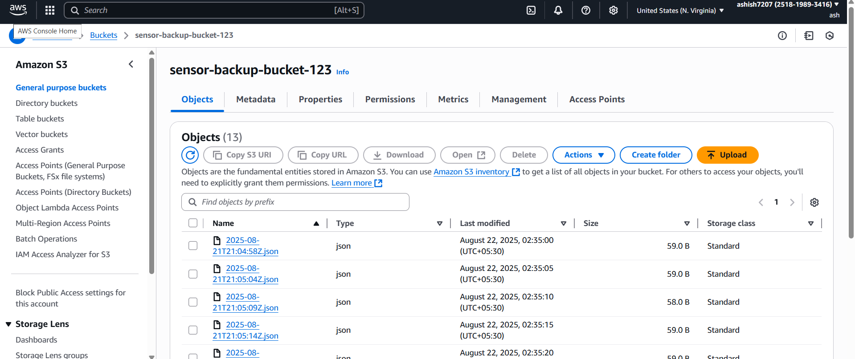
S3 Backup Output

Slide 16
Applications
Smart home monitoring.
Industrial IoT data collection.
Environmental data logging.
Data backup & recovery systems.

Slide 17
Advantages
Serverless and scalable.
Low cost and pay-as-you-go.
Automated data backup.
Secure with IAM policies.
Easy integration with other AWS tools.

